Slide 1
Circulatory system
Lecture- 17-18

Slide 2
Human Circulatory System
Lecture Outline:
Circulatory System
Parts of the Circulatory System
The Pathway of Blood Circulation
Systemic Circuit
Pulmonary Circuit
Disorders

Slide 3
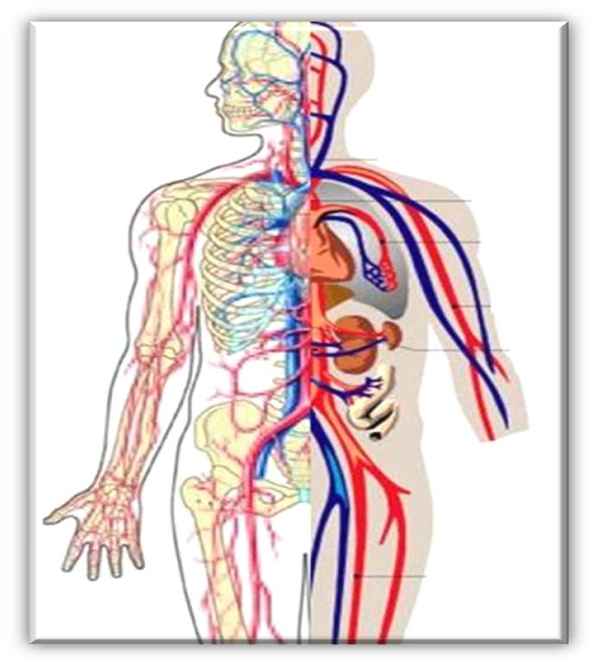
Circulatory System
Circulatory system in humans, is the combined function of the
heart,
blood and
blood vessels (arteries, veins and capillaries)
to transport oxygen and nutrients to organs and tissues throughout the body and carry away waste products.

Slide 4
Circulatory System- Vital Functions
Increases the flow of blood to meet increased energy demands during exercise and regulates body temperature.
When foreign substances or organisms invade the body, the circulatory system swiftly conveys disease-fighting elements of the immune system, such as white blood cells and antibodies, to regions under attack.
In the case of injury or bleeding, the circulatory system sends clotting cells and proteins to the affected site, which quickly stop bleeding and promote healing.

Slide 5
Circulatory System- Basic Structures
A fluid tissue (the blood and lymph).
A network of tubing (the veins and arteries) to carry the blood.
Specialized tubing (the capillaries) to allow diffusion of molecules to and from blood.
A pump (the heart) to keep the blood moving through the arteries, veins, and capillaries.

Slide 6
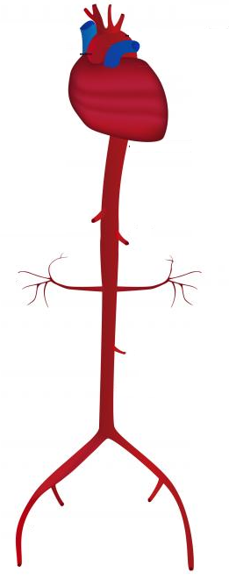
Part of the Circulatory System
Blood cell Heart P. Artery Capillary network p. vein

Slide 7
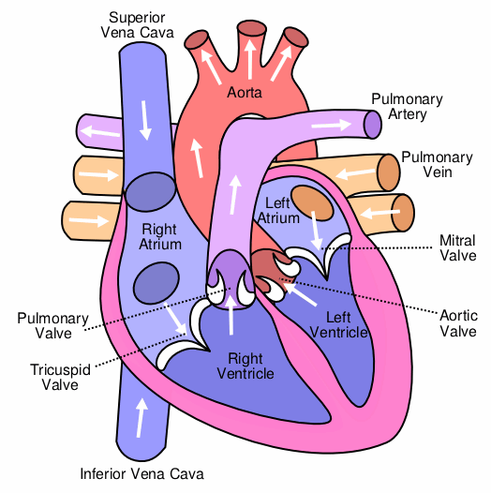
Anatomy- Heart
The heart provides the pressure needed to keep the blood flowing through the network of tubing.
The heart is the engine of the circulatory system.
It is divided into four chambers:
(1) the right atrium,
(2) the right ventricle,
(3) the left atrium, and
(4) the left ventricle.

Slide 8
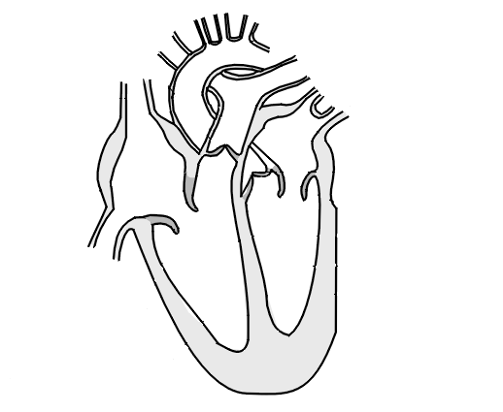
Anatomy- Heart
Structure:
The two atria collect the blood.
The two ventricles pump the blood out of the heart.
Valves prevent the blood from flowing backwards.
The septum separates the two sides of the heart.
The right side of the heart pumps de-oxygenated blood to the lungs to pick up oxygen.
The left side of the heart pumps the oxygenated blood from the lungs around the rest of the body.
Left atrium
Right atrium
Right ventricle
Left ventricle
Valves
Septum

Slide 9
Anatomy- Heart
The walls of these chambers are made of a special muscle called MYOCARDIUM, which contracts continuously and rhythmically to pump blood.
The pumping action of the heart occurs in two stages for each heartbeat:
(1) DIASTOLE, when the heart is at rest; and
(2) SYSTOLE, when the heart contracts to pump deoxygenated blood toward the lungs and oxygenated blood to the body.
During each heartbeat, typically about 60 to 90 ml of blood are pumped out of the heart. If the heart stops pumping, death usually occurs within four to five minutes.

Slide 10
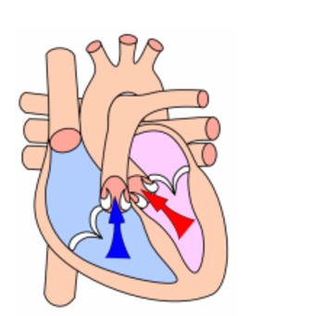
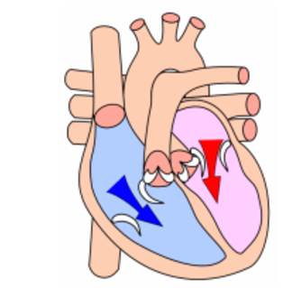
Normal range: | Diastole 60 – 80 mmHg (adults); | Systole 90 – 120 mmHg (adults);)

Slide 11
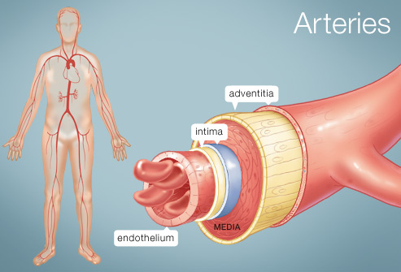
Blood Vessels
Arteries
Arteries are tubes that carry oxygenated blood away from the heart.
Arteries carry blood under the highest pressure (around 16 kPa).
The structure of an artery must be able to handle both high pressure and the changes in pressure that result from the rhythmic pumping of the heart.
Therefore, arteries are thick-walled, wrapped with elastic muscle tissue. Small arteries are called arterioles.

Slide 12
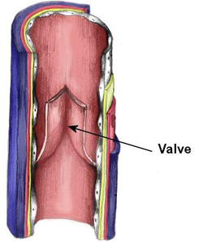
Blood Vessels
Veins
Veins are tubes that return deoxygenated
blood to the heart.
Veins provide a return system for blood under lower pressure that the blood in the arteries.
Therefore, the walls of veins do not need to be as thick or elastic as those of arteries.
The pressure of the blood coming out of the venous end of some capillaries often is not high enough to push the blood all the way back to the heart
For this reason, some veins in the legs and arms have one-way valves to ensure that the blood travels only toward the heart. Small veins are called venules.

Slide 13
Difference between Artery and Vein
Artery | Vein
Carry oxygenated blood (except pulmonary artery). | Carry deoxygenated blood (except pulmonary vein)
Carry blood away from the heart | Carry blood to the heart
Thick and elastic muscular wall. | Thin and slightly muscular wall.
Blood under high pressure. | Blood under low pressure.
Contain no valve | Contain valve
Blood moves in pulses. | No pulses.
Blood flows rapidly. | Blood flows smoothly

Slide 14
Blood Circulation in Heart:
Oxygenated blood from lungs to heart– Pulmonary vein→ left Atrium → [diastole] Left Ventricle → [systole] Aorta (to body)
Deoxygenated blood from body to heart – Superior and Inferior Vena cava →Right Atrium→ [diastole] Right Ventricle →[systole] Pulmonary Artery (to lungs)

Slide 15
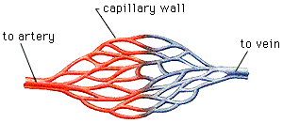
Blood Vessels
Capillaries
Capillaries connect arteries and veins.
They are a finely divided network of tiny tubes that exchange food, oxygen and wastes between blood and body cells.
Capillaries leak nutrients from the bloodstream to all cells in the body.
Cell wastes diffuse through the capillary back into the blood.
capillaries
arteriole
venule

Slide 16
The Pathway of Blood Circulation
Blood returning to the heart from the arms, head, abdomen, and legs has little oxygen left in it.
As a result, the pathway that the blood follows should put more oxygen into the blood and then direct the re-oxygenated blood back out to the body tissues.
Systemic circulation is the movement of blood between the heart and the rest of the body.
Pulmonary circulation is the movement of blood between the heart and lungs.
Each of these circuits requires its own pump.
The pulmonary circuit uses the right half of the heart;
the systemic circuit uses the left half.

Slide 17
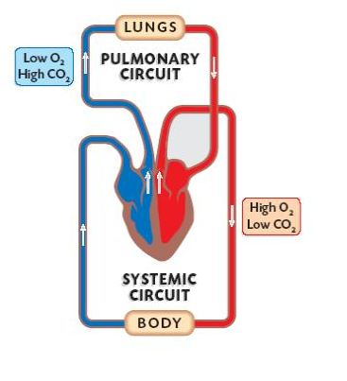
Systemic Circuit & Pulmonary Circuit

Slide 18
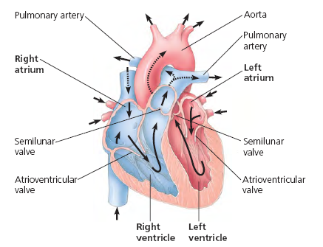

Slide 19
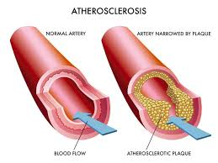
Disorders
Atherosclerosis/ Arteriosclerosis
deposits inside arteries (plaques)
develop in inner wall of the arteries, narrowing their channel
increase blood pressure
increase risk of heart attack, stroke, kidney damage

Slide 20
Disorders
Heart Attack
Acute myocardial infarction
Interruption of oxygen supply to the heart
Causes death of the heart muscle
Leading cause of death in both men and women
Stroke
Strokes usually result from rupture or blockage of arteries in the head
Brain cells are starved of oxygen and nutrients
Loss of function may occur
Can cause paralysis, loss of ability to speak or death.

Slide 21
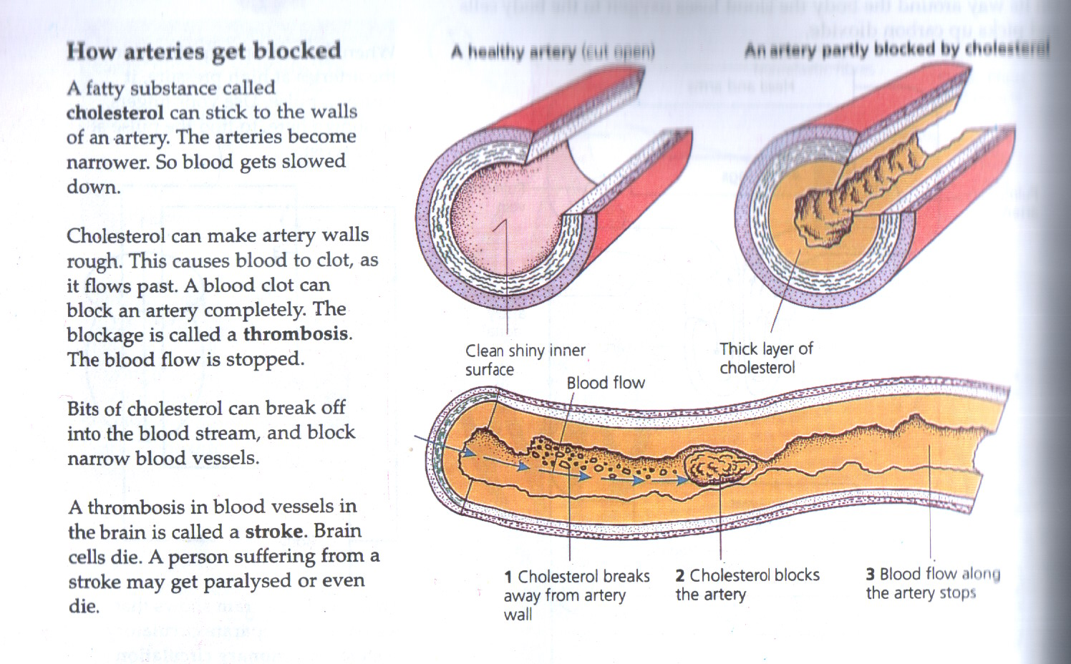
How arteries get blocked

Slide 22
How to avoid heart diseases
Cutting down on fried food. We can grill, boil or steam, rather than fry. If we do fry, we should use corn, soya or sunflower oils.
Eating less red meat.
Cutting off any fat while eating anything
Eating less dairy foods ( eggs, butter, milk and cream )
Eating more poultry and fish, because they are less fatty.
Eating more fresh fruit and vegetables.
No smoking.
Taking exercise regularly.
Taking time to relax before we go to bed.

Slide 23
What is blood?
Blood is a specialized bodily fluid that consists of a liquid matrix called plasma containing a number of cellular components and cell fragment.
Blood cells produced in bone marrow from stem cells

Slide 24
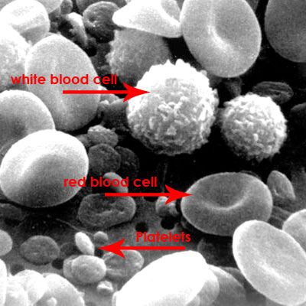
Figure – RBC, WBC and Platelets

Slide 25
Function of Blood
Blood performs many important functions within the body including:
Supply of oxygen to tissues (bound to hemoglobin which is carried in red cells)
Supply of nutrients such as glucose, amino acids and fatty acids (dissolved in the blood or bound to plasma proteins)
Removal of waste such as carbon dioxide, urea and lactic acid
Immunological functions, including circulation of white cells, and detection of foreign material by antibodies
It maintains acid base balance, body temperature.
Messenger functions, including the transport of hormones and the signaling of tissue damage.

Slide 26
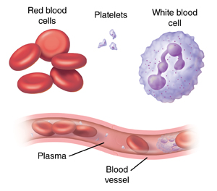
Composition of Blood
1. Plasma
Fluid part of blood
Carries carbon dioxide, hormones and waste
2. Red blood cells
Contain haemoglobin which carries oxygen
3. White blood cells
An important part of the immune system, they produce antibodies and destroy harmful microorganisms
4. Platelets
Clump together to form clots
Protect the body by stopping bleeding

Slide 27
Blood Components
They fall into two major categories:
1) The liquid component (plasma) and
2) The cellular component or formed
elements (red cells, white cells, and
platelets)

Slide 28
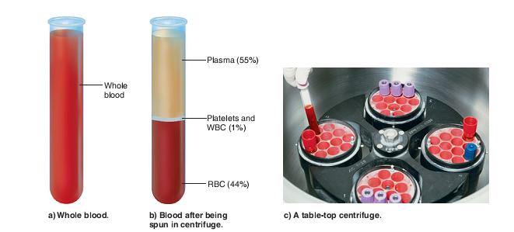
Blood Component: Plasma
If you centrifuge a blood sample, the yellowish clear liquid will be found on the on the top, called plasma (55%)
Plasma composed of water (90%), proteins (~10%) and other solutes.

Slide 29
Plasma
The largest group of solutes in plasma consists of plasma proteins, which serve a variety of functions.
Important plasma proteins include albumins, globulins, and clotting proteins.
Albumins:
2/3 of total protein
Maintain the proper water balance between blood and the interstitial fluid.
Manufactured in the liver.
Albumins also bind to certain molecules (such as bilirubin and fatty acids) and drugs (such as penicillin) and assist in their transport in blood.

Slide 30
Plasma
Globulins:
Globulins (designated alpha, beta, and gamma) transport various substances in the blood.
Many beta globulins bind to lipid (fat) molecules, such as cholesterol. When a protein attaches to one of these molecules, it creates a complex called a lipoprotein.
Two medically important lipoproteins are the low-density lipoproteins (LDLs) and high-density lipoproteins (HDLs).

Slide 31
Plasma
Globulins:
The LDLs are sometimes called “bad cholesterol,” because high blood levels of these lipoproteins are associated with increased risk of cardiovascular health problems.
High levels of HDLs often indicate a lower risk of cardiovascular disease.

Slide 32
Plasma
Clotting proteins:
Clotting proteins, a third group of plasma proteins, play an important role in the process of blood clotting. blood clotting minimizes blood loss and helps maintain homeostasis after injury.
Plasma also contains other substrate;
Electrolytes - Na⁺, K⁺, Ca⁺⁺, Mg⁺⁺
Nutrients - glucose, amino acids, fatty acids,
monoglycerides
Gases - O₂, N₂, CO₂
Regulatory substance - hormones, enzymes, Vitamins
Wastes

Slide 33
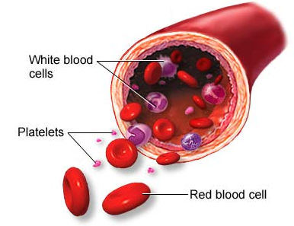
Blood Components: Formed elements
There are mainly 3 types of
blood cells;
Red blood cells or erythrocytes
White blood cells or leukocytes
Platelet or thrombocytes

Slide 34
Formed elements
Red Blood Cells
White Blood Cells
Platelets
Granulocytes
Polymorphonucleated
Agranulocytes
Mononucleated
NEUTROPHILS
EOSINOPHILS
BASOPHILS
MONOCYTES
LYMPHOCYTES

Slide 35
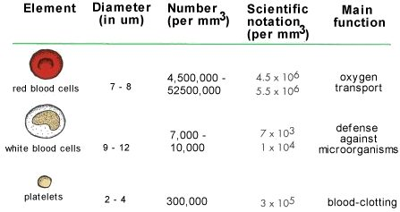
Blood cells – Formed Elements

Slide 36

Red blood cell
Red blood cells are small, flattened, doughnut-shaped disks whose centers are thinner than their edges.
It makes them flexible, so they can bend and flex to squeeze through tiny blood vessels.
They are red because they contain a protein called hemoglobin that is red in color because of iron

Slide 37
Red blood cell
Red blood cells carry oxygen to body tissues and remove carbon dioxide (which bound with hemoglobin).
The process by which red blood cells are produced is called erythropoiesis.
Erythrocytes are continuously being produced in the bone marrow of large bones, at a rate of about 2 million per second. (In the embryo, the liver is the main site of red blood cell production).
In an adult, the total count of RBC is 4.5 to 5.5 million per mm³ of blood.

Slide 38
White blood cell
White blood cells are cells of the immune system defending the body against both infectious disease and foreign materials.
WBCs are found throughout the body, including the blood and lymphatic system.
White cells called phagocytes can eat up the germs that cause diseases.

Slide 39
Platelets
Platelets result from cell fragmentation and are involved with clotting by carrying chemicals essential to blood clotting.
There are 150,000 to 300,000 platelets in each milliliter of blood.
Without blood platelets, you would bleed to death.
Platelets survive for 10 days before being removed by the liver and spleen.

Slide 40
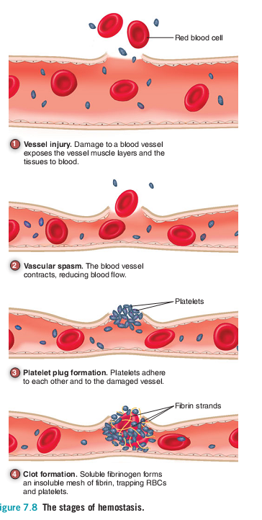
Platelets (contd.)
If a blood vessel is cut, platelets stick to the edges of the cut and to one another, forming a plug that stops bleeding.
They then release chemicals that react with fibrinogen and other clotting proteins, leading to the formation of a blood clot.
The blood vessel can then heal over the cut area.

Slide 41
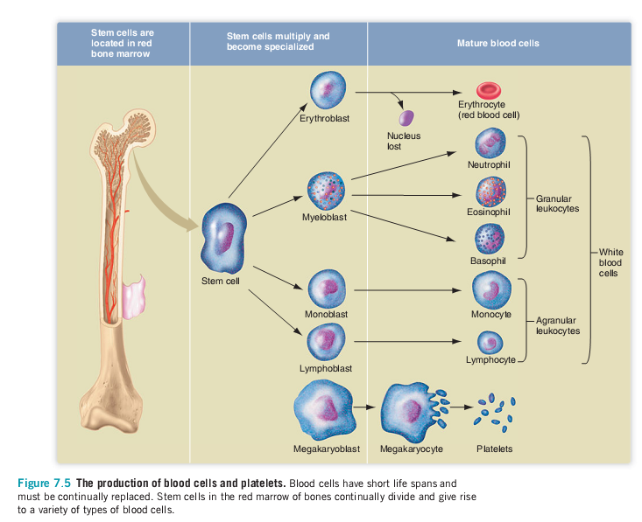
Production of Blood Cells

Slide 42
Types Of Blood
Human blood is grouped into four types:
A, B, AB, and O based on two antigens A and B
Each letter refers to a kind of antigen, or protein, on the surface of red blood cells.
Each blood type is also grouped by its Rhesus factor, or Rh factor
Blood is either Rh positive (Rh+) or Rh negative (Rh-).

Slide 43
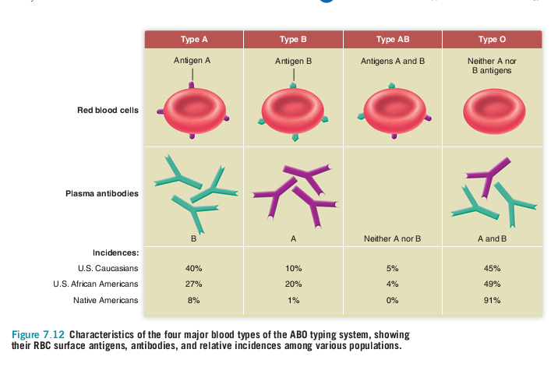

Slide 44
Types Of Blood
Type O- blood is considered the “universal donor” because it can be donated to people of any blood type. It contains no antigen.
Type AB+ blood is considered the “universal recipient” because people with this type can receive any blood type. It contain both the antigens and will not produce any antibody against foreign antigen.

Slide 45
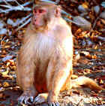
Rh blood type
Another red blood cell surface antigen,
called Rh factor
Rh+ ……individual has Rh antigen
Rh-……individual do not has Rh antigen;
their immune systems respond to
any foreign Rh antigen by making
antibodies against it

Slide 46
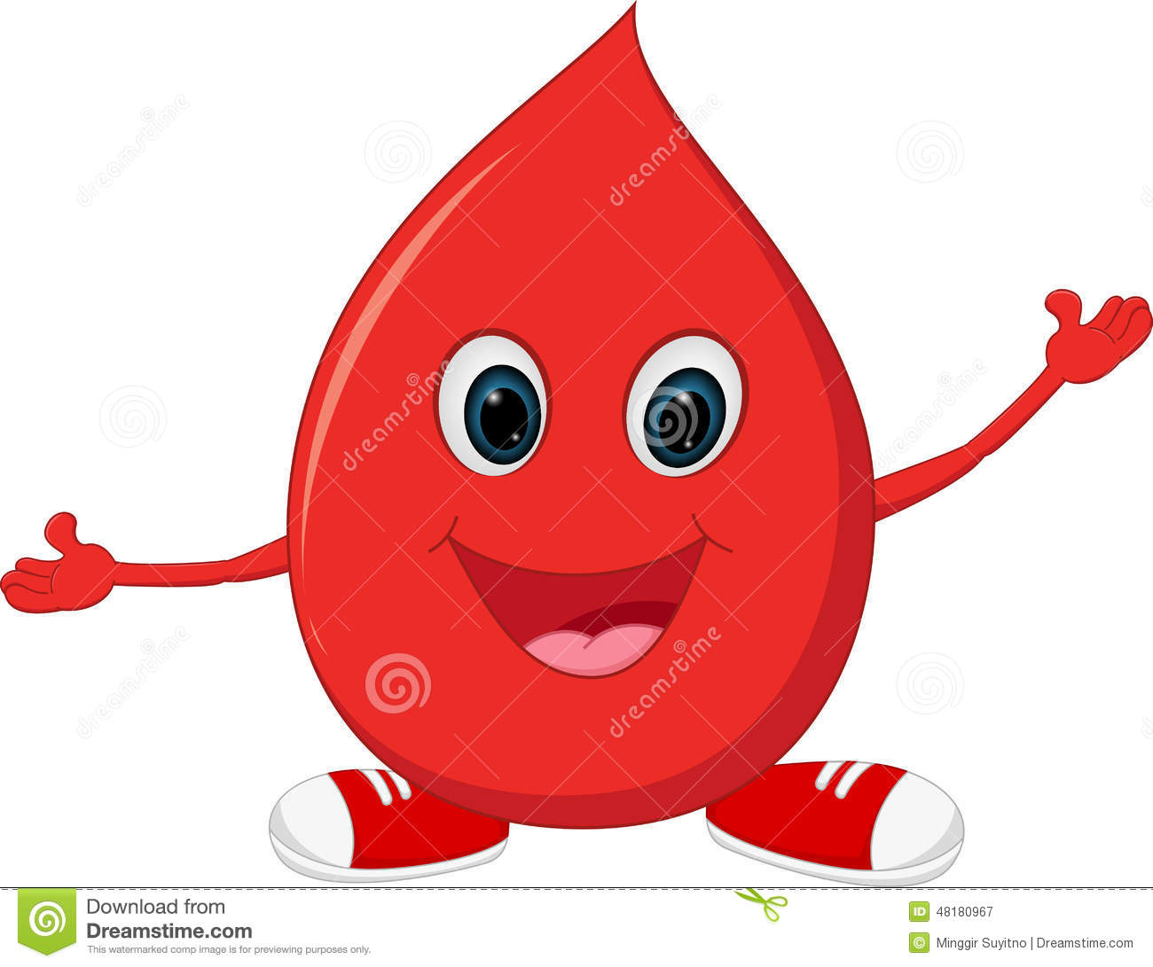
Questions?

